Slide 1
Weekly Updates – UNCDF PROJECT
Presented By: ChapChap Africa
Title: UNCDF Project
Date: December 18th, 2025

Slide 2
AGENDA
Outreaches conducted
Way Forward
SME trained and Onboarded

Slide 3
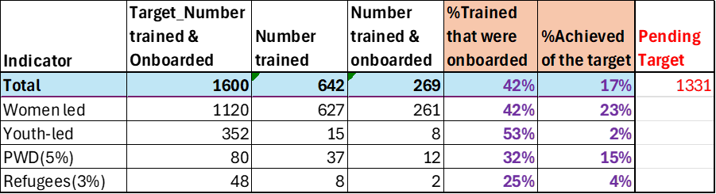
SMEs trained &onboarded onto the app

Slide 4
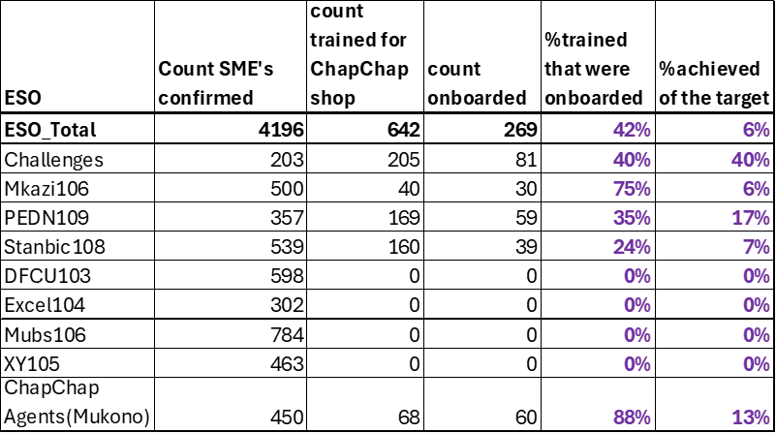
ESO Count of SMEs for the 10X Project

Slide 5
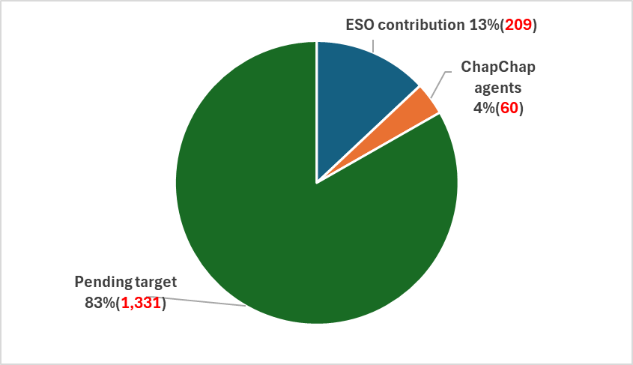
ESO and ChapChap Agent contribution to overall target
Tranche 2 Target: 1,600 SME's Trained & onboarded

Slide 6
Activities Update
Name of Entrepreneur Support Organization | Date of Outreaches | District of implementation
Stanbic Business Incubator DONE | 24th – 26th November 2025 | Wakiso – Mapeera – Nabunya Wakiso – Nakuwadde Mukono – Mandeleo Foundation
Tech Challenges Uganda DONE | 25th & 28th November 2025 | Omoro, Nwoya, Gulu
Mkazipreneur DONE | December 5th &12th | Mukono, Kampala
(PEDN) DONE | December 6th | Busia, Sironko, Bulambuli, Tororo Kapchorwa, Mbale, Pallisa
ChapChap Agents in Mukono – over 2 days DONE | 10th – 11th December 2025 | Mukono District – Mukono Resort Hotel

Slide 7
Upcoming Activities
Name of Entrepreneur Support Organization | Date of Outreaches | District of implementation
ChapChap Agents in Wakiso - Potential pipeline of 2,600 | Week starting 22nd December 2025 | Wakiso – Different divisions of the district. Locations to be confirmed
NANSANA – 195 Pipeline | 22nd December 2025 | Wakiso – Makutano Gardens, Nansana
KIRA – 200 Pipeline | 6th and 7th January 2026 | Wakiso – Kasangati Resort
MAKINDYE SABAGABO – 200 Pipeline | 9th and 10th January 2026 | Wakiso – Zana
ABAITA BABIRI – 200 Pipeline | 12th and 13th January 2026 | Wakiso – Abaita
WAKISO MUNICIPALITY – 200 pipeline | 19th and 20th January 2026 | Wakiso Municipality

Slide 8
Challenges and Strategies towards impoving project performance
Some Challenges:
Some training participants mobilized by ESO's were below 18 years or above 35 years
Upto about 50% of attendees did not have smartphones but locations like Tororo which is peri-urban had a lower percentage
Some phones had low battery, which could mean poor quality devices or poor usage knowledge of the devices
Suggested Actions
To benchmark on the ChapChap clients that are currently using the agent app that have small business
To recruit & train a team of community champions that will be given target number of SME's to train & onboard within their catchment.
To re-engage ESO's to provide lists of SME's that have been trained in the 10X program foundation course.

Slide 9
Observations
Opportunities for device-financing companies at the recommended price points of the target audiences
The willingness-to-pay and ability-to-pay surveys for device financing conducted by the ESO showed an appetite to purchase smartphones ranging between USh 300,000 and USh 400,000, with payment periods ranging from 1 month to 6 months
The attendees had a high appetite for business loans from the number of questions asked in the Q&A sessions
Training of attendees in some district necessitated the need for a translator in delivering the training. This ability to provide for translations in various languages proved successful. In Pallisa for example, 4 languages were used to deliver the training (English, Luganda, Ateso and Lugwere)
In 5 districts, ChapChap used the ESO ToTs to deliver the trainings, which proved successful and may point to the long-term sustainability of the project.

